Slide 1


Supply Chain Control Tower

Slide 2


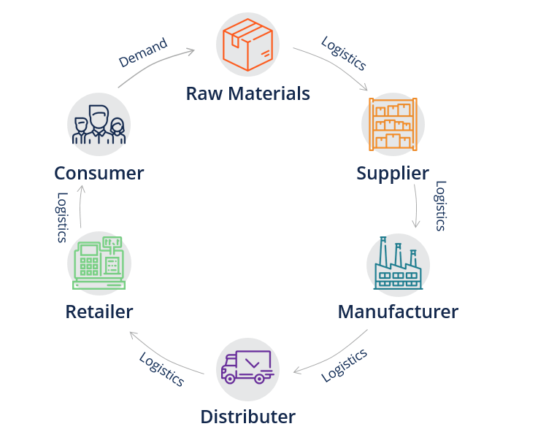
Domain – Supply Chain Management
Supply management is the act of identifying, acquiring, and managing resources and suppliers that are essential to the operations of an organization. It includes the purchase of physical goods, information, services, and any other necessary resources that enable a company to continue operating and growing.

Slide 3
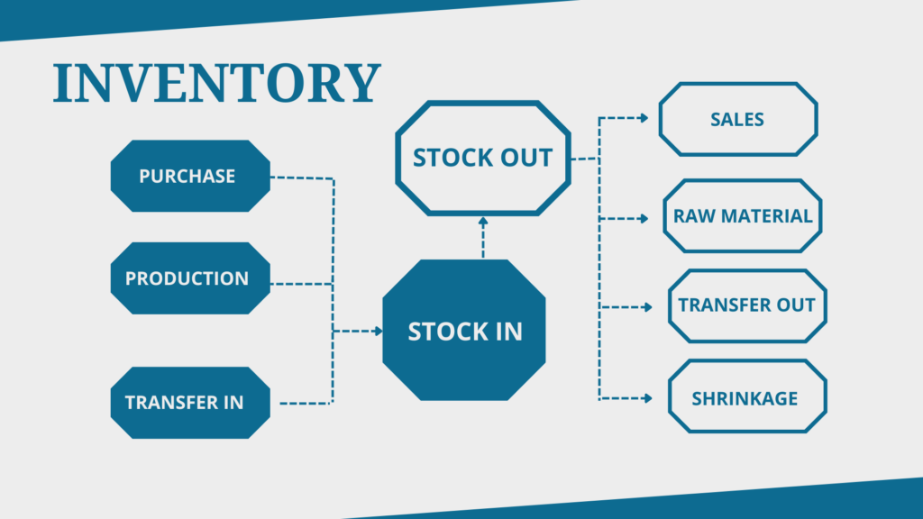
Problem Statement
Create a cost-effective, user-friendly supply chain management system for small and medium-sized businesses, focusing on streamlining operations, optimizing inventory, enhancing order processing, and strengthening supplier relationships. Key features include inventory management, order processing, supplier management, volume tracking, sales/profit analysis, demand forecasting, and comprehensive analytics/reporting.

Slide 4
Solution Breakdown
Features
User-Friendly Interface
Demand Forecasting
Inventory Management
Volume Tracking
Order Processing

Slide 5
Solution
User-Friendly Interface:
The supply chain management system will feature a clean and intuitive user interface, designed specifically for ease of use by small and medium-sized business owners and employees.
Inventory Management:
Users can efficiently manage their inventory levels, track stock movement, and set up automatic reorder points to ensure optimal inventory levels.
Benefits: Reduction in excess inventory costs, minimization of stockouts, and improved inventory turnover ratios.

Slide 6
Solution
3. Order Processing:
Streamlined order processing capabilities will enable users to process orders quickly and accurately, from receiving to fulfillment.
Benefits: Faster order fulfillment, improved customer satisfaction, and reduced order processing errors.
4. Supplier Management:
The system will provide tools for managing supplier information, communication, and performance evaluation.
Users can track supplier contacts, pricing, delivery schedules, and quality metrics.
Benefits: Enhanced supplier relationships, better negotiation capabilities, and improved supply chain reliability.

Slide 7
Solution
5. Volume Tracking:
Real-time volume tracking features will allow users to monitor inventory levels, sales volumes, and order volumes.
Benefits: Improved inventory planning, better demand forecasting accuracy, and reduced stockouts or overstock situations.
6. Sales/Profit Analysis:
Users will have access to detailed sales and profit analysis tools, including sales trends, profit margins, and product performance metrics.
Benefits: Insights into revenue streams, identification of high-margin products, and opportunities for revenue optimization.

Slide 8
Solution
7. Demand Forecasting:
Advanced demand forecasting algorithms will help users predict future demand based on historical data, market trends, and seasonal variations.
Benefits: Reduced inventory holding costs, minimized stockouts, and improved customer service levels.
8. Comprehensive Analytics/Reporting:
The system will offer comprehensive analytics and reporting capabilities, allowing users to generate customized reports and dashboards.
Reports may include inventory turnover, supplier performance, order fulfillment rates, and profitability analysis.
Benefits: Data-driven decision-making, identification of inefficiencies, and opportunities for continuous improvement.

Slide 9
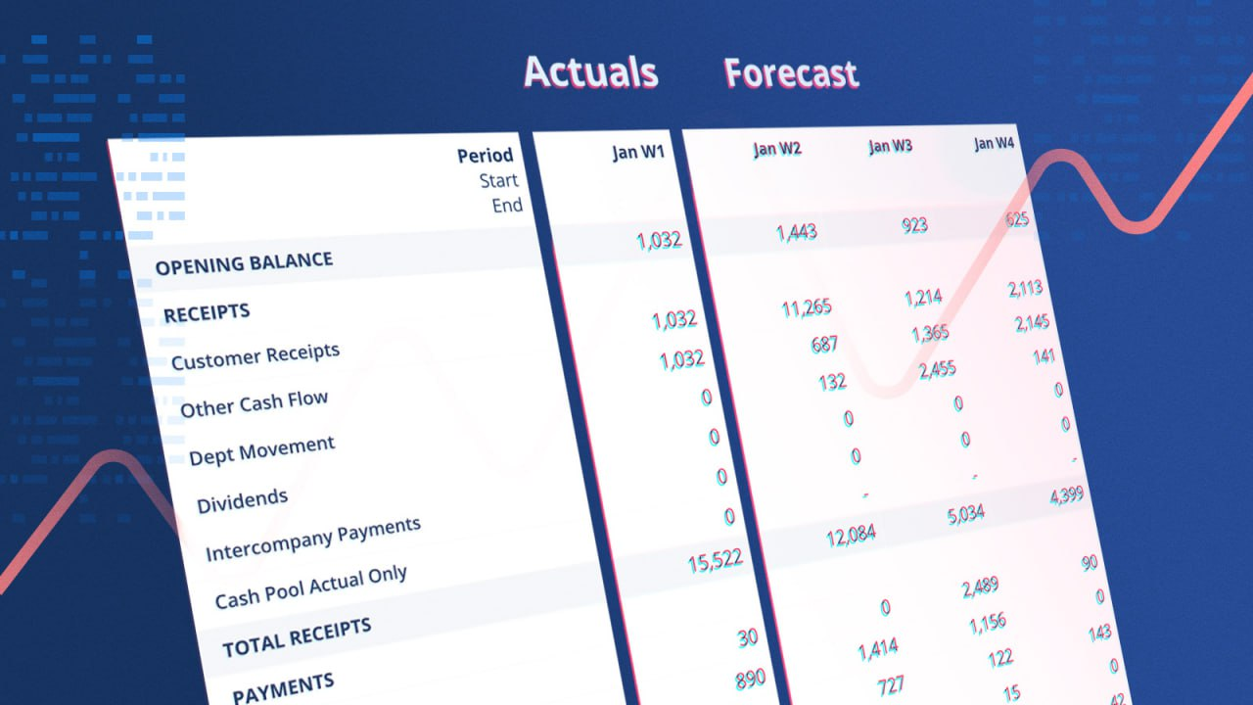
WHY?
Real-time Financial Insights: Financial dashboards provide retailers with real-time visibility into their financial performance
Data-Driven Decision Making: With access to comprehensive financial data and analytics, retailers can make informed decisions regarding inventory management, pricing strategies, marketing campaigns, and resource allocation.

Slide 10
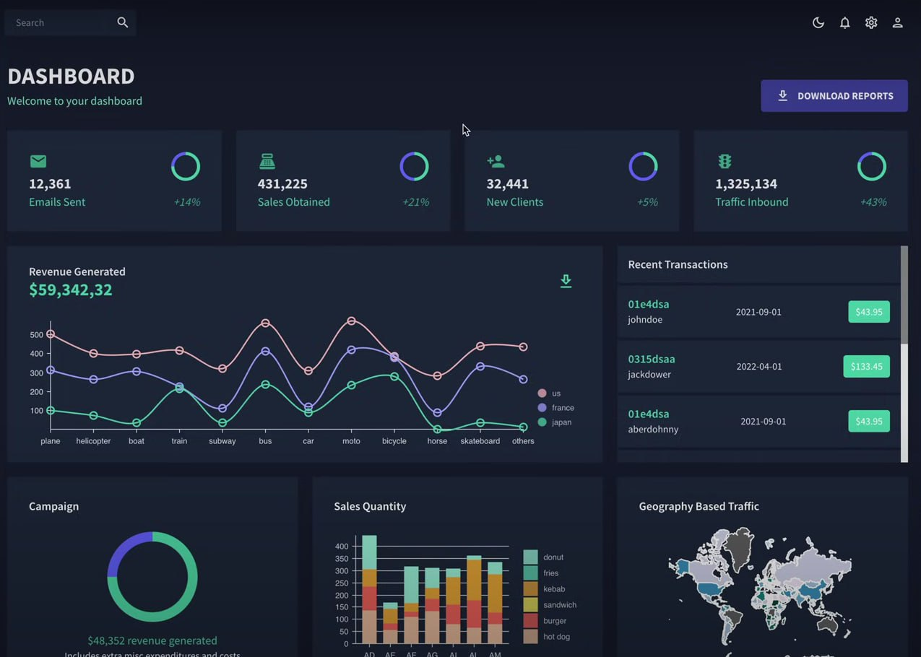
USP
Small companies don’t need the depth and the various features provided by big companies like SAP and Oracle.
So we can provide them with optimal features with affordable prices making our product cost effective.

Slide 11
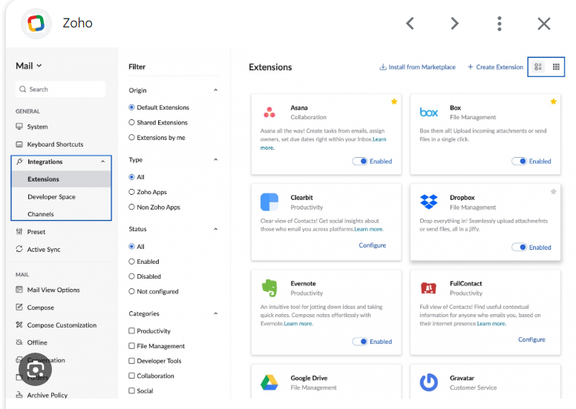
Existing Solutions
There are few existing solutions like Zoho ,kibana etc., which provide these facility.
We provide more appealing and detailed graphs about the companies financials. We are more cost effective!

Slide 12
Thank You!

